Slide 1




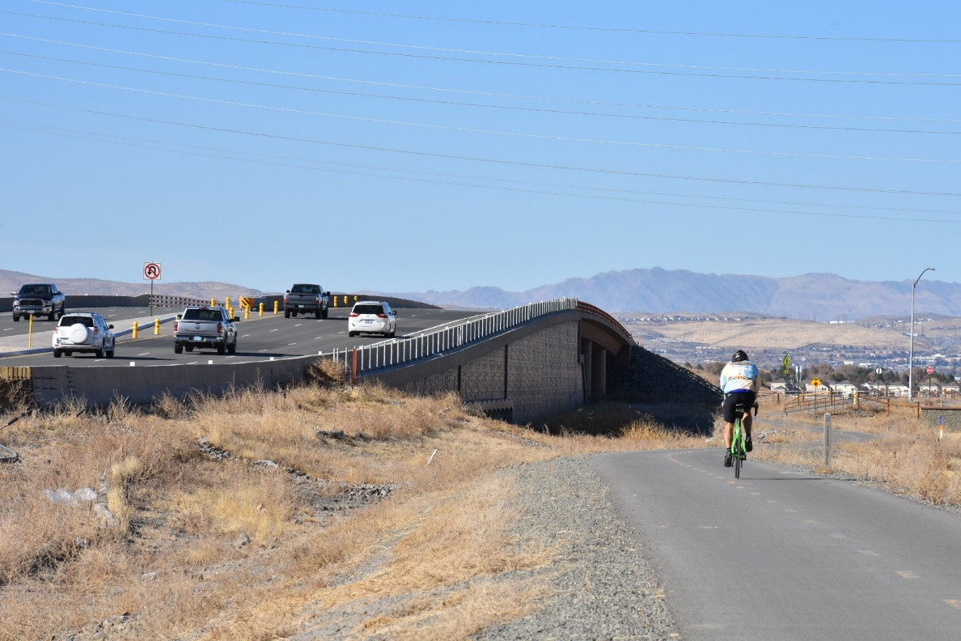

Sparks City Council – RTC Projects December 14, 2020

Slide 2

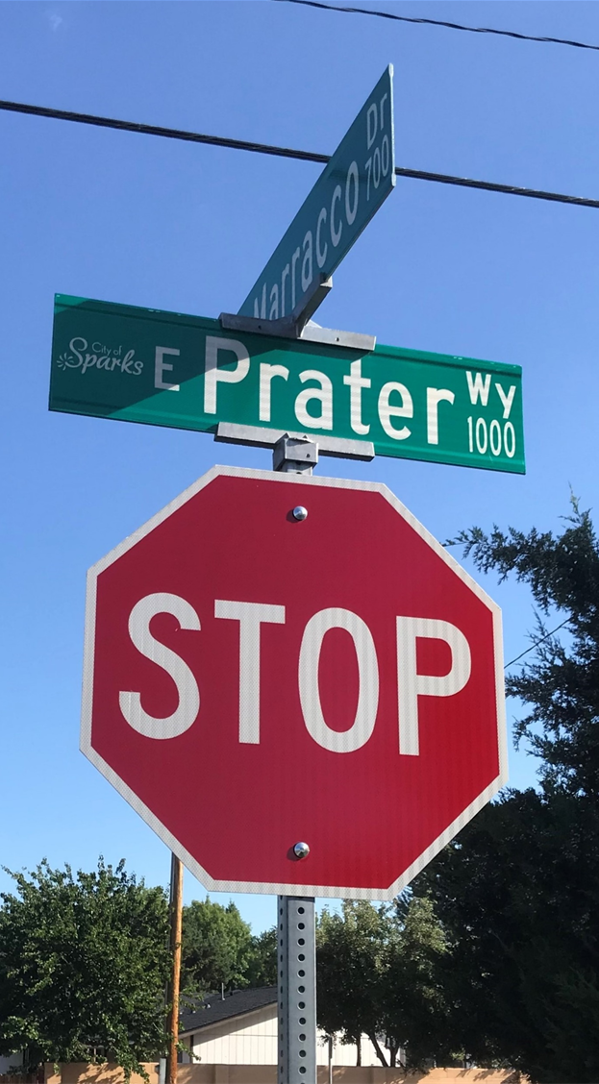
2020 Construction in the City of Sparks
East Greg Street
East Prater Way
2020 Preventive Maintenance
Traffic Signal Timing (Sparks Blvd.)

Slide 3
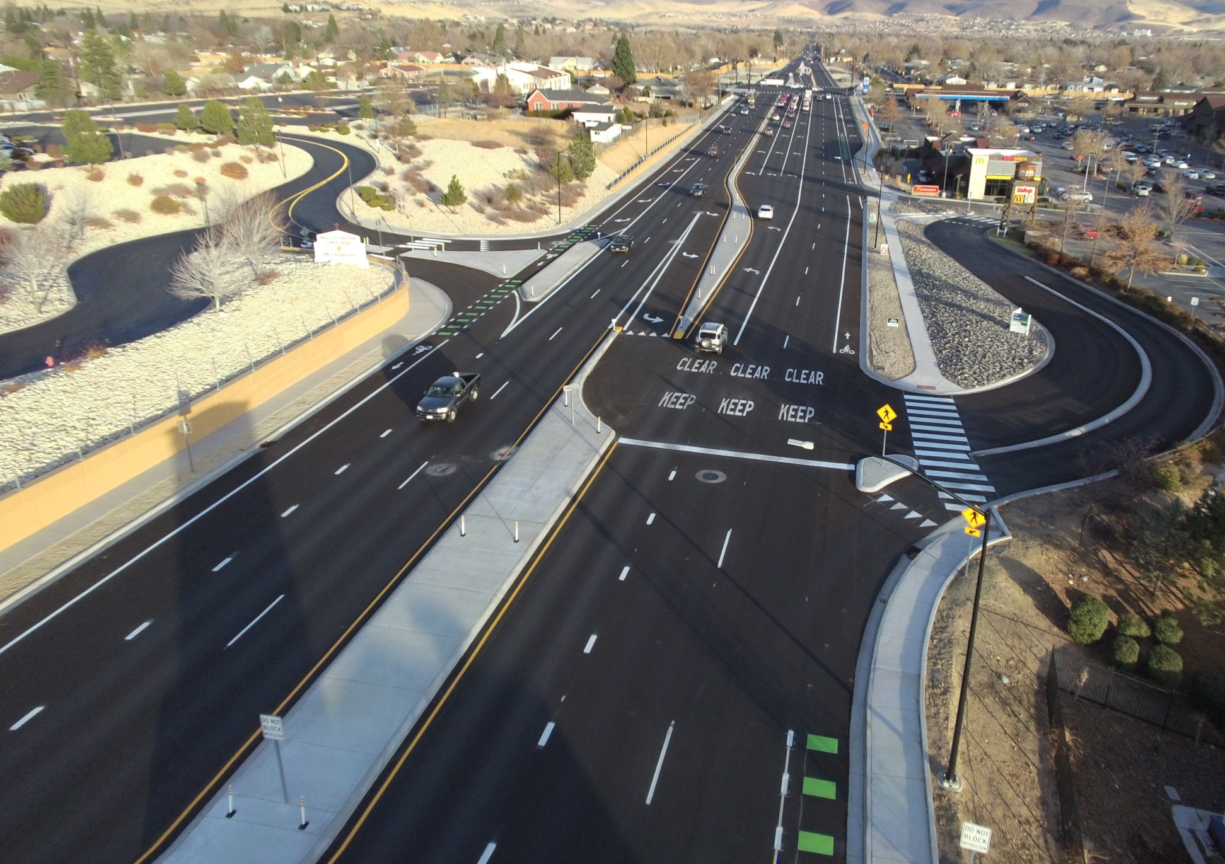
Continuing Major Projects within City of Sparks
Bus stop ADA Improvements/Pedestrian Connectivity
Oddie/Wells Boulevard Complete Street
Pyramid Hwy Widening
Sparks Boulevard Widening

Slide 4
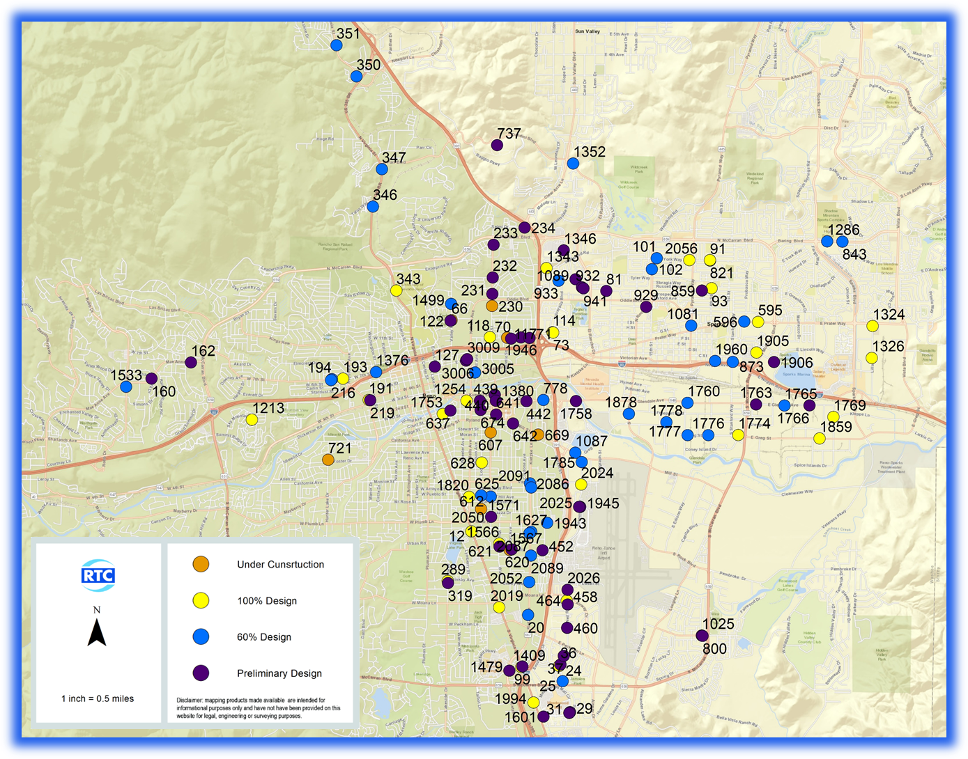
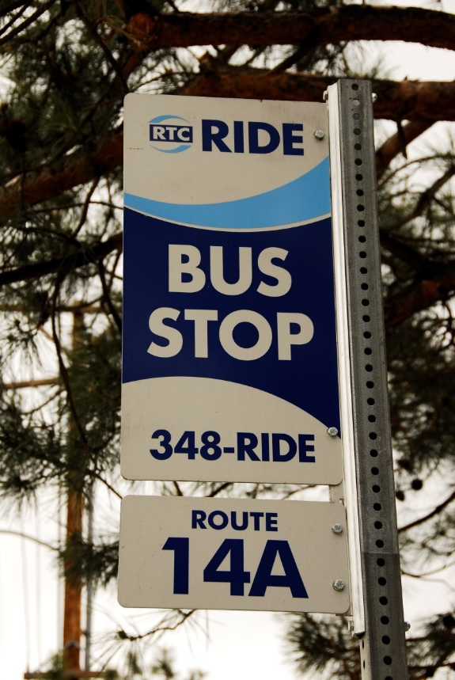
Bus stop ADA Improvements and
Pedestrian Connectivity
FUNDING
Programmed for $2 Million per year (3 years)
Design and Advertise Multiple Packages

Slide 5
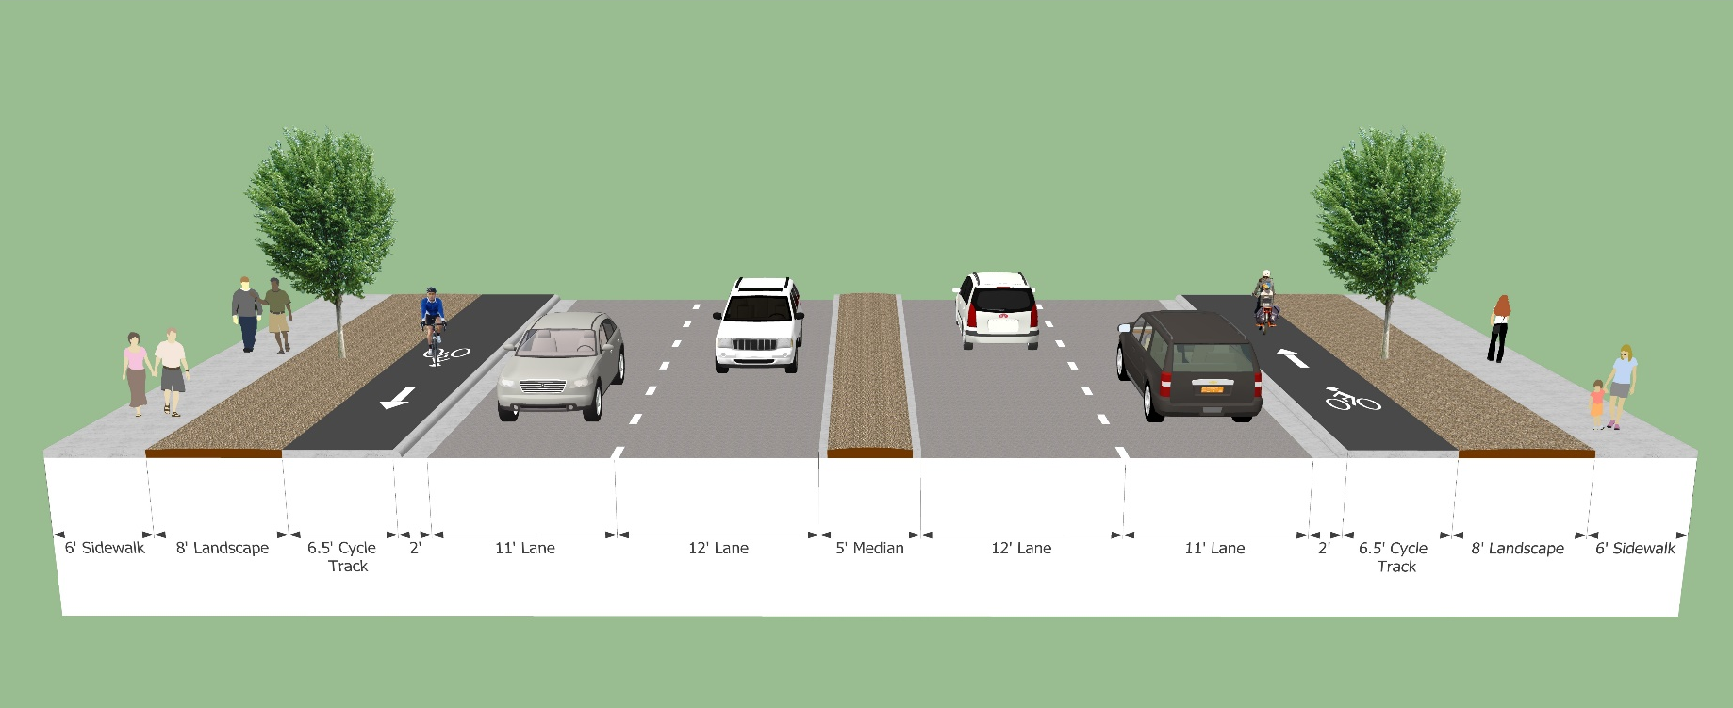
Oddie Wells Project
Complete Street project
Focus on safety and mobility
Wider sidewalks and bike facilities
Lighting and esthetics
SCHEDULE
Advertise | Early 2021
Start Construction | Summer 2021
Construction Completion | Summer 2022

Slide 6
Sparks Boulevard
Capacity & multimodal improvements
Greg Street to Baring Boulevard
Proposed Construction 2024 start

Slide 7
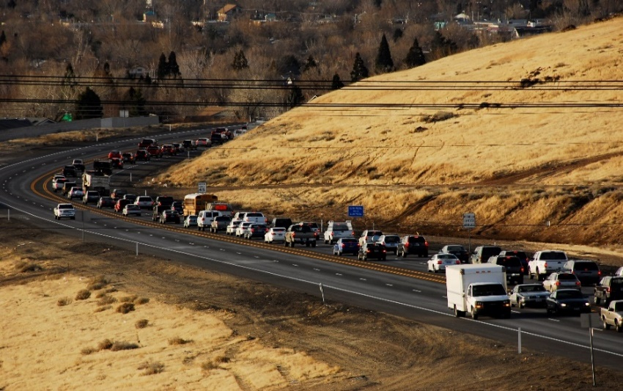
Pyramid Highway and US 395 Connector
Multi-phase project in Regional Transportation Plan
Capacity & multimodal & safety improvements
Phase 1 (NDOT will design and administer the construction project)
Pyramid widening -Queen Way to Los Altos
Multi-Modal Improvements – Lost Altos to Golden View Drive
Anticipated Construction Start 2023
Estimated Construction Cost $45 million
$23 million from BUILD Grant
$5 million from State Funding
$8 million from other Federal Funding
$9 million from RTC Fuel Tax

Slide 8
2021 Construction for City of Sparks
Packer Way
Wild Island Court
El Rancho – Oddie to Greenbrae
York & Pyramid
Victorian at Battle Born & 16th
ADA Access Transit/Pedestrian Connectivity
ITS 3 – Rock Boulevard from Greg to Prater Way

Slide 9
2022 ICA City of Sparks
2022 Preventative Maintenance
2022 Roadway Rehab/Reconstruction
TE Spot 11
Traffic Management/ITS
ADA Access Transit/Pedestrian Connectivity

Slide 10
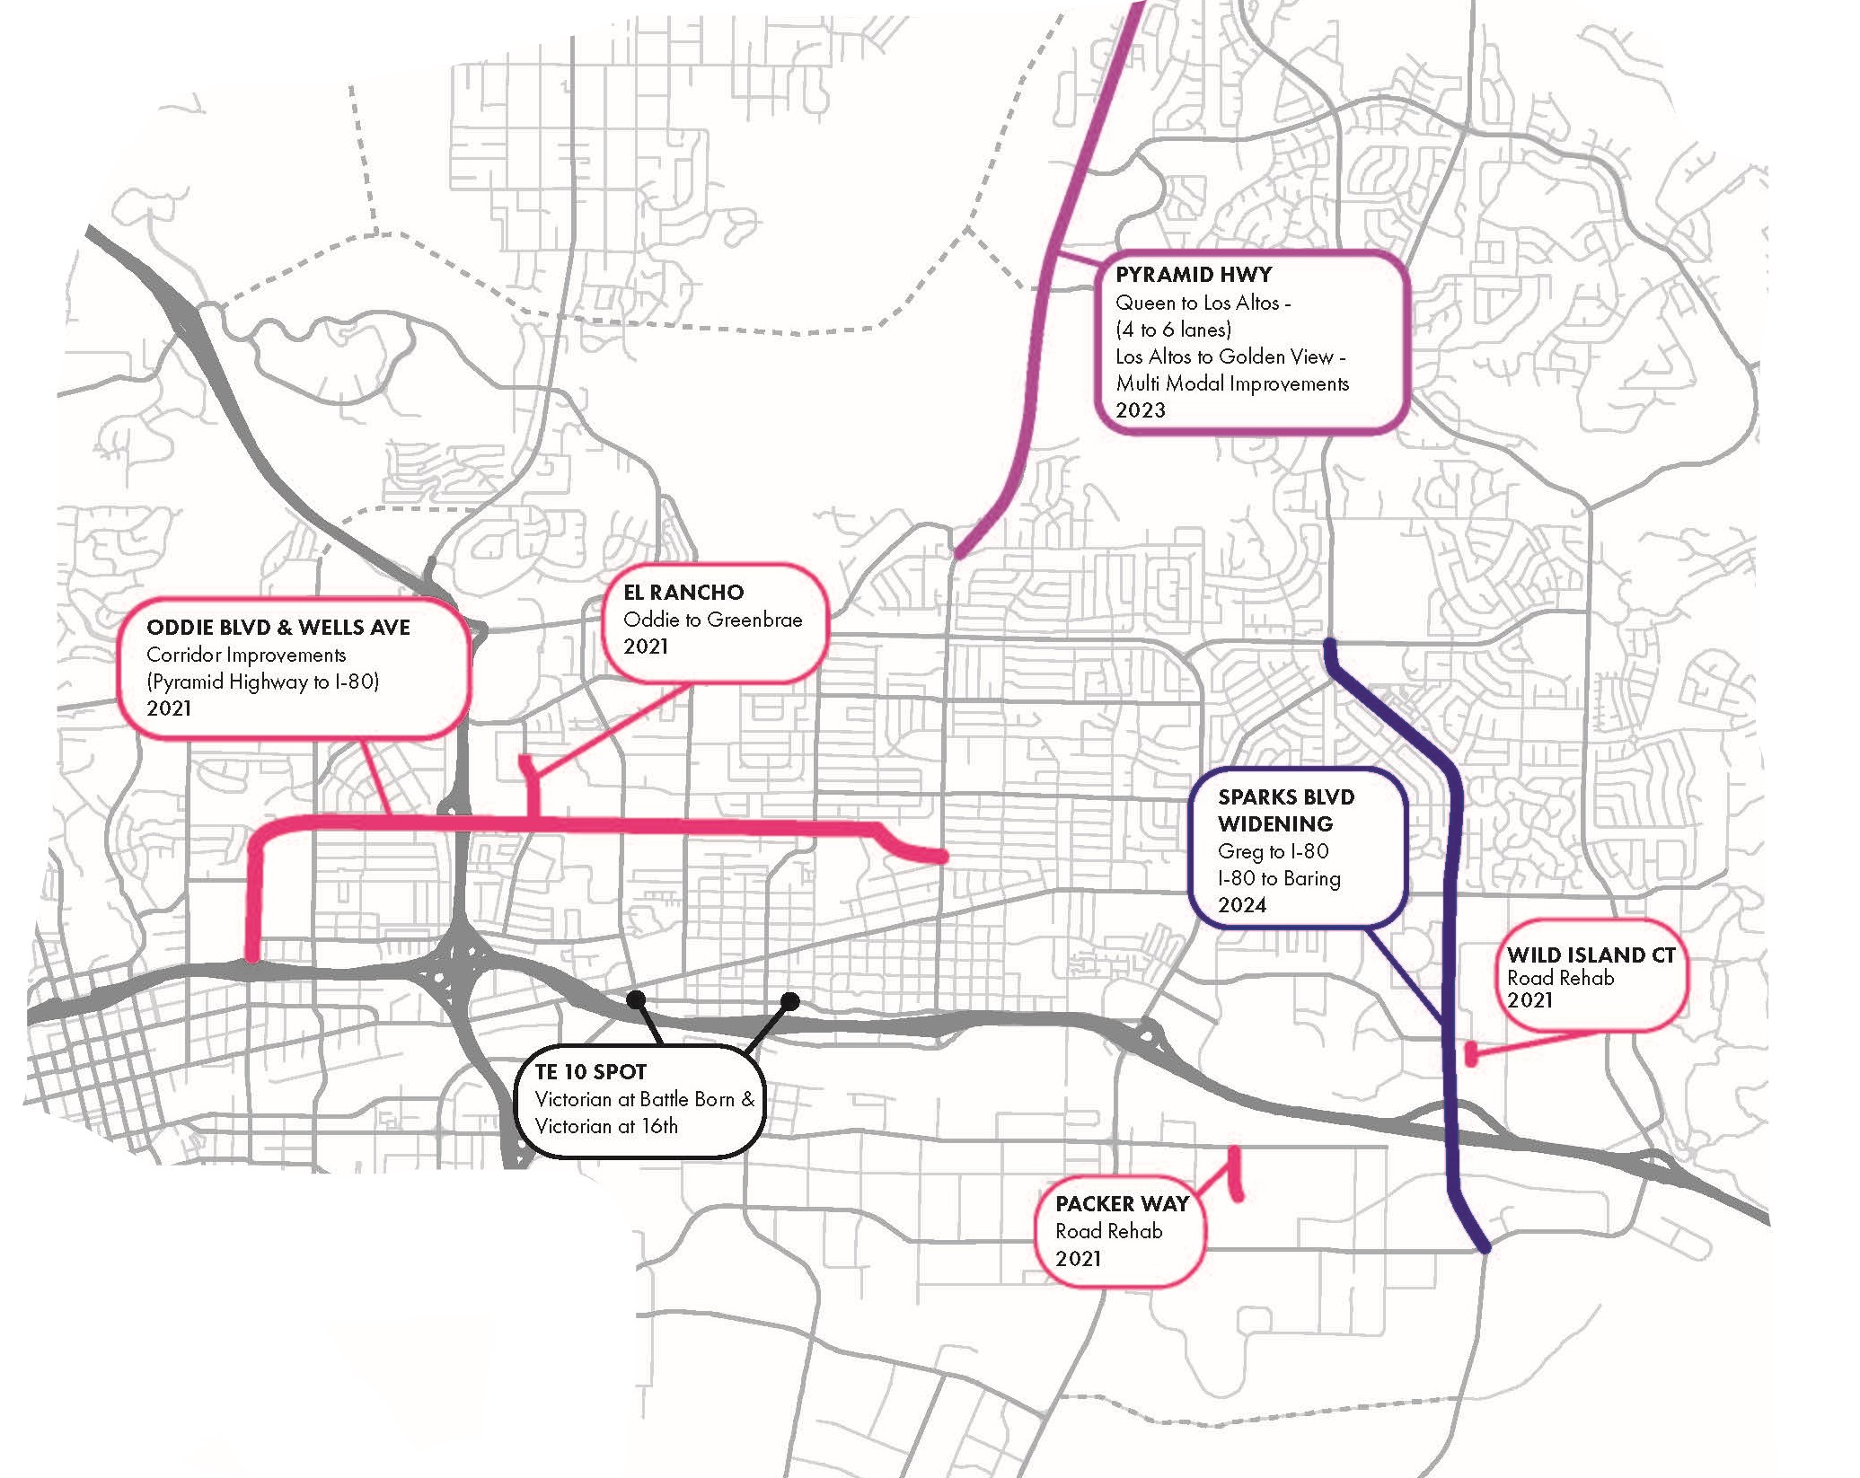

Slide 11

THANK YOU
Brian Stewart
Director of Engineering
Regional Transportation Commission of Washoe County
bstewart@rtcwashoe.com
rtcwashoe.com
Your RTC. Our Community.

